Slide 1
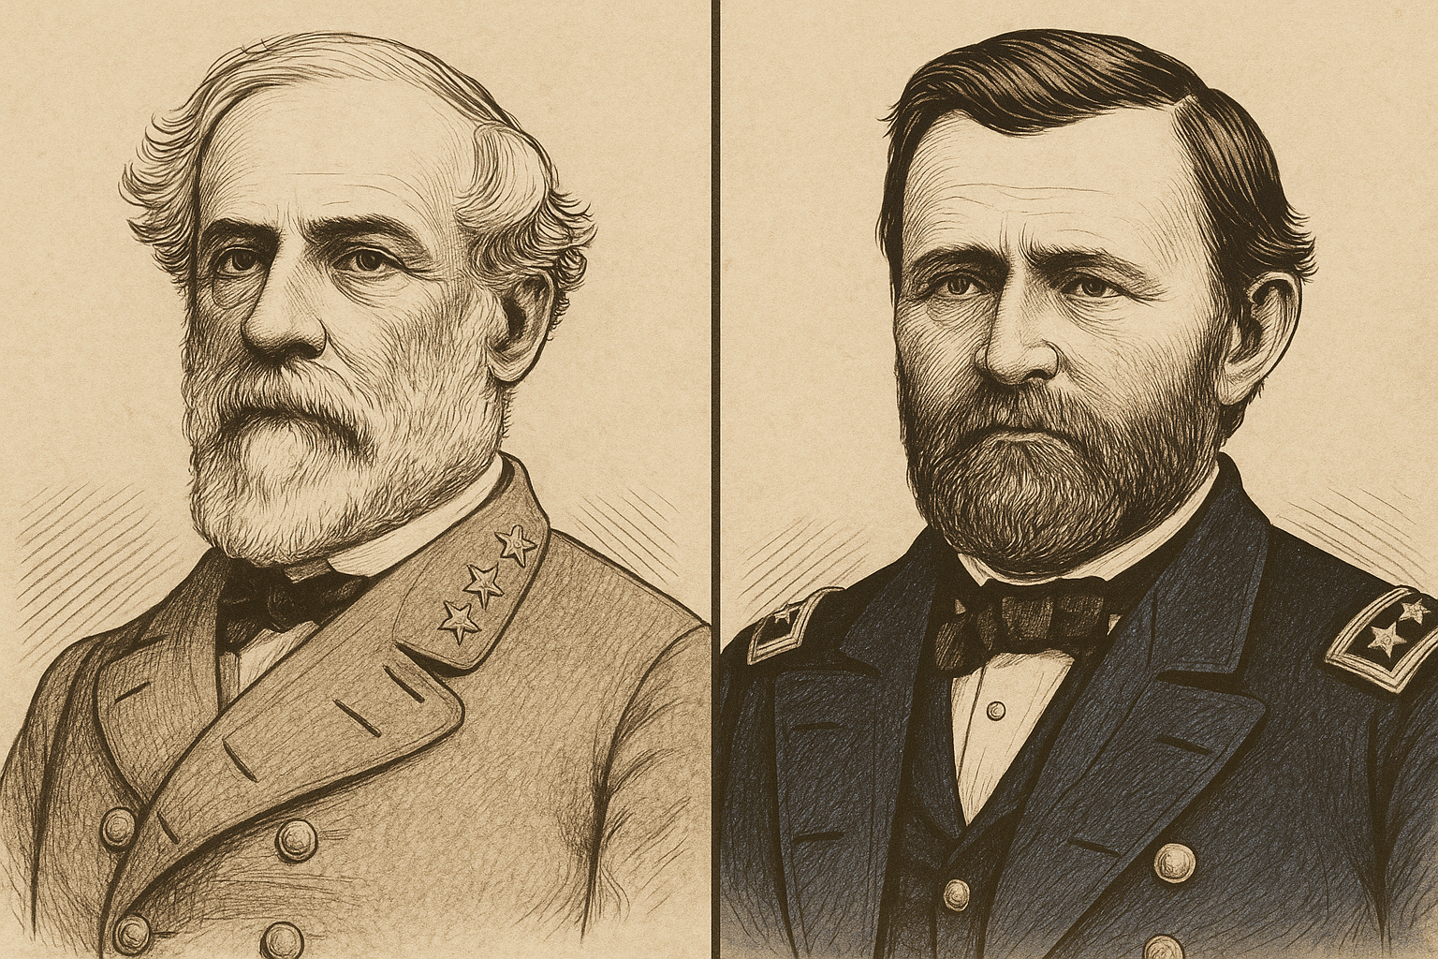
Leadership Comparison Graphic Organizer: Robert E. Lee & Ulysses S. Grant

Slide 2
Category | Robert E. Lee | Ulysses S. Grant
1. Military Background: Education, early career, Civil War role | He commanded the confederates in the war and won the respect of the south and foreigners for his power and diplomatic skills. | He served 2 terms as president, commanded the north to victory, and had a very bad and dishonest presidency. He also tried to protect the rights of the formerly enslaved.
2. Key Battles/Strategies: Name 2 major battles and describe strategies used | His strategies focused on offensive attacks and on capitalizing tactical opportunities on the opponent. | One battle that made him famous was fort Donelson when he caried the union to victory. Another was Fort henry where he fought and lead his troops with the same or similar strategies in the first battle.
3. Personalities: Give 2-3 words to describe each | Thoughtful refined general. | Surrendering slob.
4. Risk-Taking: Describe instances of bold or cautious leadership | He would always take risks for opportunities to take over enemies. | He took some risks in the battles he lead like fort Donelson and fort henry. He also won both of those battles, so the risks must have paid off.
5. Communication & Relationships: With soldiers, officers, and political leaders
6. Discipline & Morale: How they motivated and managed their troops | His whole family was very well distinguished and they were one of the most powerful families, therefore being rich people with good plans. So he had to follow his families great honorable legacy.
7. Leadership Style: Match to a leadership theory (e.g., transformational, authoritarian)
8. Legacy: How are they remembered? What impact did they leave? | He was not really remembered, but he | He was remembered by some as a great leader and a mid president, and remembered by others as a slob with bad strategies.

Slide 3
Short Reflection
Answer the following in 1–2 sentences:
In your opinion, who was the stronger leader overall, and why?
ANSWER: Robert E Lee was stronger because he had better strategies overall and a smarter game plan.
What surprised you most in comparing their leadership?
ANSWER:

